Slide 1
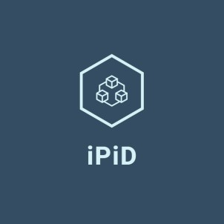
BRIDGING MOJALOOP WITH THE REST OF THE WORLD
Damien Dugauquier Co-Founder and CEO iPiD
Michael Richards
Financial Services Principal
Modus Box
PI-18 OSS Community Meeting April 25-28, 2022
CONFIDENTIAL - DO NOT SHARE WITHOUT IPID CONSENT

Slide 2


AGENDA
Who are we?
What we have in common with Mojaloop
Linking it back to the Mojaloop roadmap to interconnect with the rest of the world
The importance of digital remittances for low and middle income countries
Q&A / discussions with the audience
The role of iPiD in the infrastructure of global payments
Global addressing service
Connector to closed-loop ecosystems (wallets and payment systems)

Slide 3
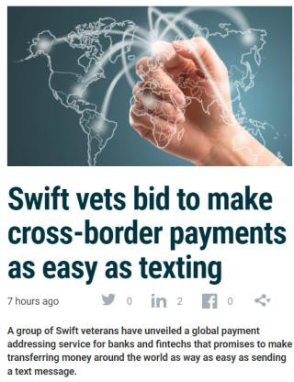







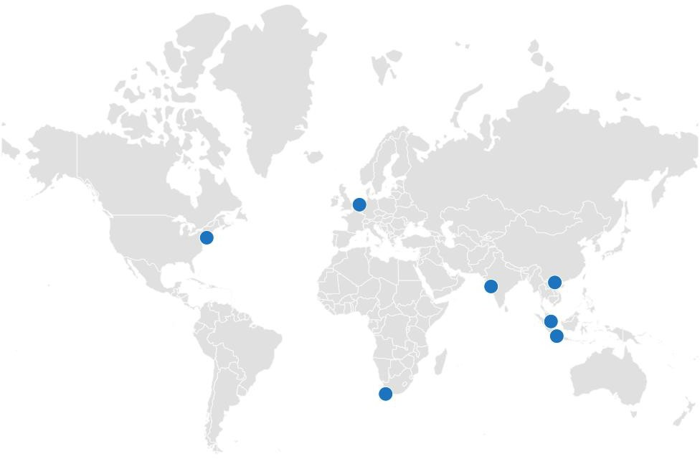



IPID WAS FOUNDED BY A GLOBAL TEAM OF EXPERIENCED PAYMENT AND TECHNOLOGY PROFESSIONALS
Leadership team
As featured in
Damien Dugauquier
Ex-head of Data and Analytics at SWIFT
Built SWIFT advisory practice for cross-border payments
Eddie Haddad
Ex-Managing Director APAC at SWIFT
Ex-Managing Director APAC at Thomson Reuters
Geertjan van Bochove CEO & co-owner Dutch IT company
Ex-SWIFT in various roles covering payments, data and liquidity management
Christian Sarafidis Chief Bus Dev Officer at Microsoft WW Financial Services
Nick Lewins
Ex-CTO Commonwealth Bank Australia
Kosta Peric Deputy Director, Financial Services for the Poor, at Bill & Melinda Gates Foundation
Stuart Thornton
Co-Founder and Ex-CEO Hoolah (leading BNPL in South East Asia)

Slide 4

WHAT WE HAVE IN COMMON
Payments based on a proxy within the
Mojaloop deployment
Payments based on a proxy for cross-border

Slide 5

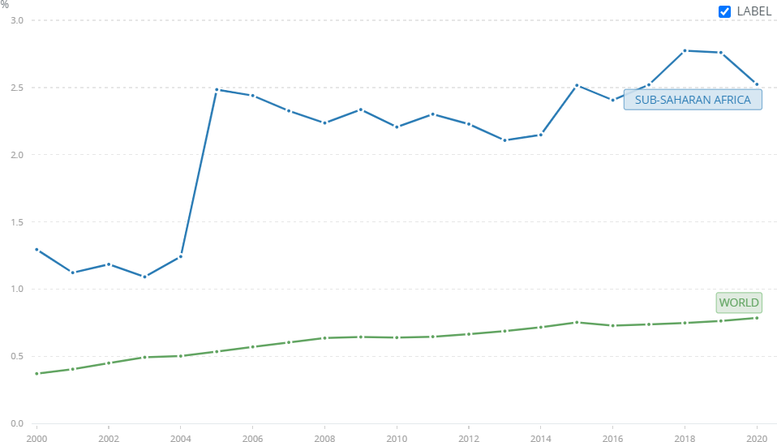
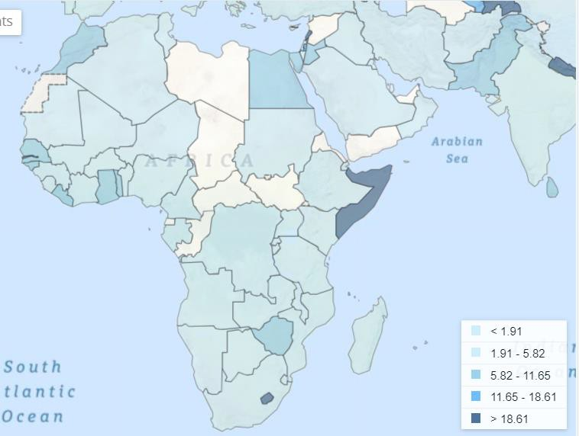
REMITTANCES ARE AN IMPORTANT CONTRIBUTOR TO ECONOMIC GROWTH IN EMERGING MARKETS
Personal remittances received as % of GDP
Evolution 2000 - 2020 Distribution in Africa by country, 2020
Source: World Bank staff estimates based on IMF balance of payments data, and World Bank and OECD GDP estimates.

Slide 6
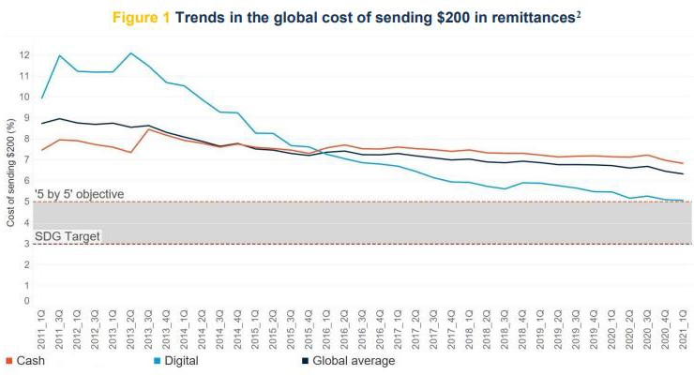
DIGITIZATION OF REMITTANCES ALLOWS FAMILIES TO GROW REMITTANCE INCOME
Global cost of sending $200 in remittances, in %
Source: World Bank, Remittance Prices Worldwide - Issue 39, September 2021

Slide 7


HOW CAN IPID PLAY ITS PART TO ACCELERATE DIGITIZATION AND LOWER FEES
Improve User Experience
Reduce Operational Costs
Make remittances as easy as sending a text message
Most payments fail because of data errors

Slide 8
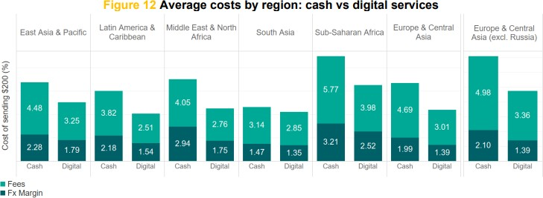
SUB-SAHARAN AFRICA HAS A LARGE OPPORTUNITY TO REDUCE REMITTANCE COSTS (AND FEES)
Average cost of sending $200 in remittances, in % by channel and by region (2020)
Source: World Bank, Remittance Prices Worldwide - Issue 39, September 2021

Slide 9


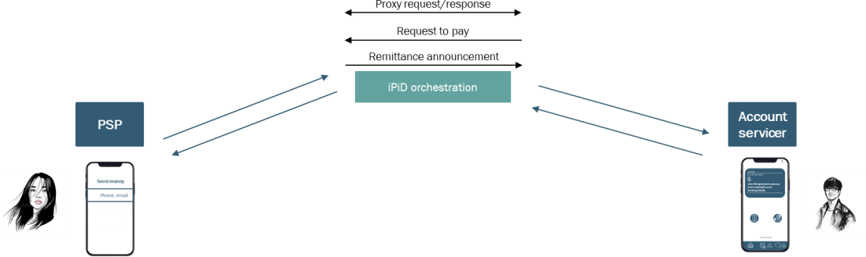
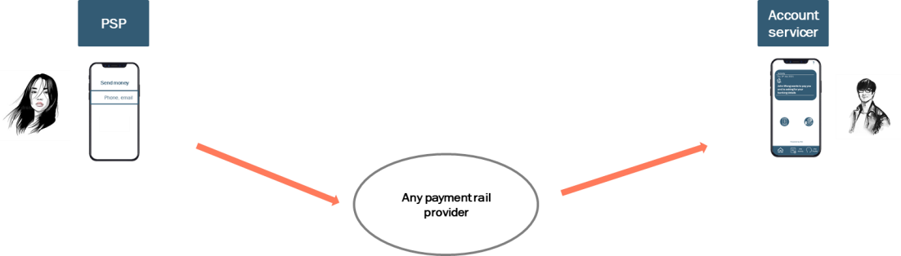
IPID SOLVES A DATA AND INFRASTRUCTURE PROBLEM WHILE BEING AGNOSTIC TO THE SETTLEMENT RAILS
iPiD orchestrates the data flow for proxy payments
iPiD does not change how payments are settled
Addressing and proxy resolution
Connector to proxy-based environments (Wallets & payment
system)

Slide 10

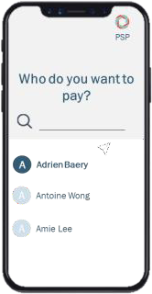





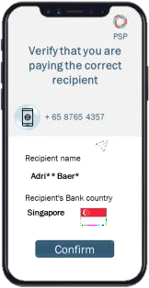
PROXY RESOLUTION FOR REMITTANCES TO BANK ACCOUNTS
SENDING INSTITUTION
RECEIVING INSTITUTION
+65 8765 4357
Unique Token
Unique Token
+65 8765 4357
Payment application
iPiD node 2
iPiD Pathfinder
iPiD node 1
Core application
Customers
Front-end
Unique Token = 1
Adrien Baery 23 Red Road Singapore ABC Bank ABCBSGSG 543535454
rwgrgewgrhgahhH Ewkjfhgiewugfolij.lj GRGeefefefeffefffewhtr Hththeqarqa Wdq;kjo;fhqeih;qa
rwgrgewgrhgahhH Ewkjfhgiewugfolij.lj GRGeefefefeffefffewhtr Hththeqarqa Wdq;kjo;fhqeih;qa
Adrien Baery 23 Red Road Singapore 3543535454
CONFIDENTIAL - DO NOT SHARE WITHOUT IPID CONSENT

Slide 11






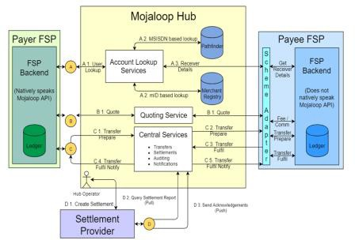
CONNECTOR TO PROXY-BASED ENVIRONMENTS (WALLETS & PAYMENT SYSTEM)
Wallet bank account
Funding flow (outside of iPiD)
Wallet 1
Your wallet
User wallet
Remittance partners
Exchange houses
Wallet bank account
Fintech
Wallet 2
Your wallet
User wallet
Banks
Aggregators
iPiD data flow Addressing & pre-validation
I
Instructions
I
Confirmation I
Reporting
FX provider
11

Slide 12






CONNECTOR TO MOJALOOP-BASED SCHEME (CROSS-NETWORK PROVIDER)
Mojaloop-based scheme
Expand volumes into scheme
Banks
Sending institutions outside of Africa
Wallets
Payment fintech
What iPiD does
Expand the reach of scheme
Single API that acts as an adapter and connector to non-Majaloop environments by mapping the Mojaloop business logic (Addressing>Quote>Transaction) to other payment APIs
Non-Mojaloop wallet and banks in Africa
Collaboration with FX/Settlement provider
iPiD acts as a data bridge but does not process payments nor FX. Non-Mojaloop institutions who want to leverage the scheme (directly or indirectly) via iPiD will have to work with Settlement/FX institution for the clearing and settlement.

Slide 13




GOALS
CROSS-BORDER INTEROPERABILITY
USER EXPERIENCE
LOWER COSTS
DATA SECURITY

Slide 14
Focus on the cross-network provider 1: who does what?
Foreign exchange provider
3
CNP manages currency conversion
1
2
Cross network provider
6
Originating institution makes a payment request via iPiD
iPiD routes the request to the appropriate Mojaloop CNP
Switch records obligations and manages settlement
Payment requests
Mojaloop switch
4
CNP transfers funds (in target currency) to beneficiary
5
CNP reports on status to iPiD
Beneficiary's DFSP

Slide 15
Focus on the cross-network provider 1: who does what?
This is scheme-specific, and the CNP will always be responsible for settling remittance obligations
In which case, so will these be…
Foreign exchange provider
We assume that these will be of a standard form…
3
CNP manages currency conversion
2
Currency conversion can be managed in a standard way, provided that target schemes support it…
6
1
Cross network provider
Originating institution makes a payment request via iPiD
iPiD routes the request to the appropriate Mojaloop CNP
Switch records obligations and manages settlement
Different schemes may have different requirements for regulatory compliance. How will these be communicated to sender institutions?
Payment requests
Mojaloop switch
4
CNP transfers funds (in target currency) to beneficiary
5
CNP reports on status to iPiD
Beneficiary's DFSP
This assumes that schemes will permit single-phase transfers from sources outside the scheme

